Slide 1

Module 2
Multi-Label Classification
Notes:
Guidelines
Use section headers to chunk content in your presentation.
Use the same style of section header throughout your presentation.
Keep your title to no more than 2 lines.

Slide 2
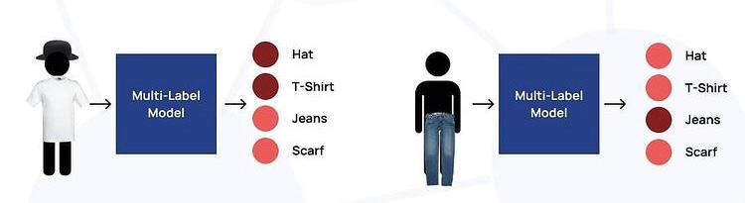
Multi-Label Classification
Notes:
Guidelines
Use a title slide at the beginning of your presentation. There are 9 variations of title slides to choose from.
If you will have a series of slideshows, we recommend using the same style of title slide for each presentation.
Keep your title to no more than 2 lines.
Do not change the font style or font size of the title or subtitle.

Slide 3
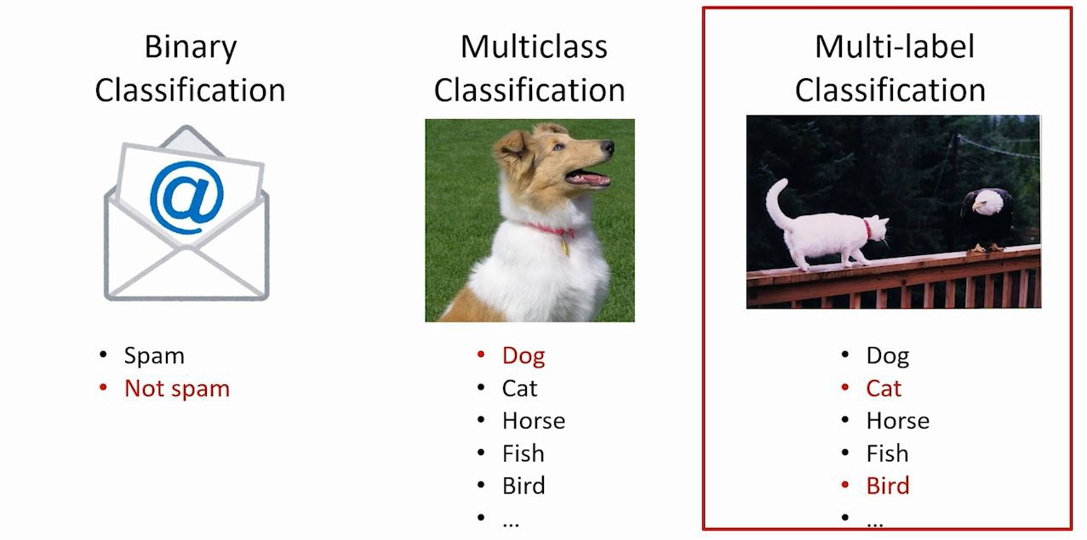
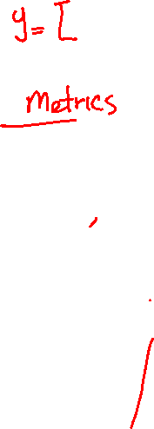
Types of Classification Problems
The 3 main classification problems are:

Slide 4
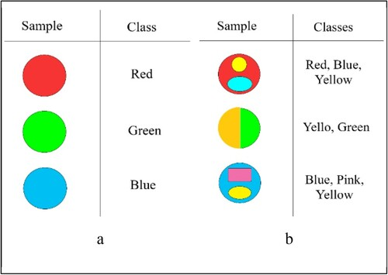
Multi-Label Classification
is the supervised learning problem where an instance may be associated with multiple labels

Slide 5
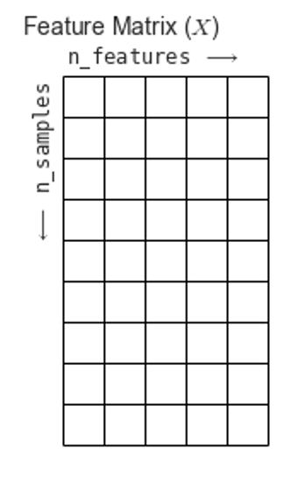
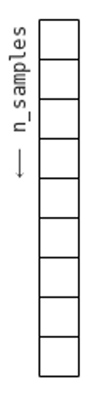
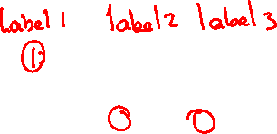
Multi-Label Classification
0
1
1
0
0
1
1
0
0
0
1
0
1
0
1
0
1
0
1
0
0
1
1
1
0
0
0
Response matrix

Slide 6
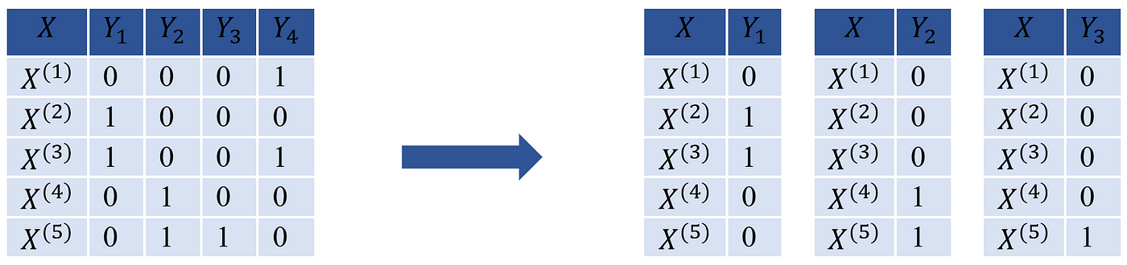
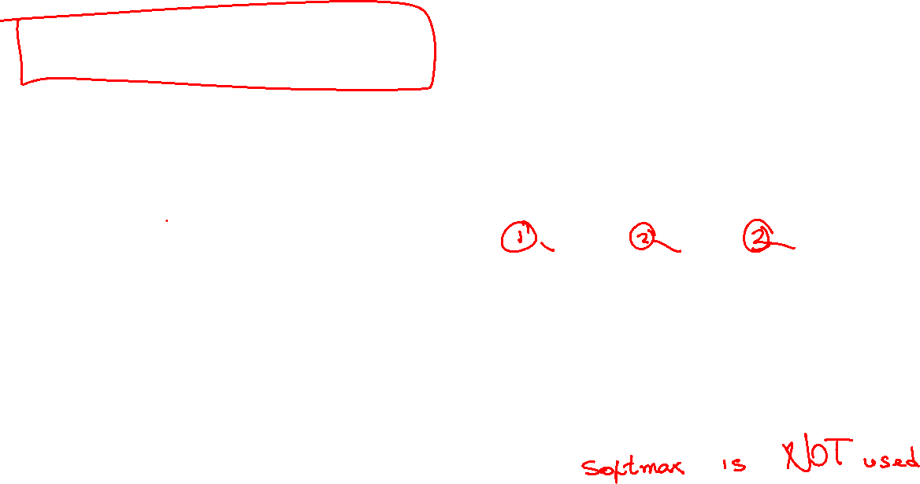
Binary Relevance
Decomposes learning tasks into independent binary problems.
Returns a propensity/prediction vector for each response
We fit each response independently

Slide 7

Fitting Each Response Independently
X
y
0
1
1
0
0
1
1
0
0
0
1
0
1
0
1
0
1
0
1
0
0
1
1
1
0
0
0
Response matrix

Slide 8
Fitting Each Response Independently
X
y
0
1
1
0
0
1
1
0
0
0
1
0
1
0
1
0
1
0
1
0
0
1
1
1
0
0
0
Response matrix

Slide 9
Fitting Each Response Independently
X
y
0
1
1
0
0
1
1
0
0
0
1
0
1
0
1
0
1
0
1
0
0
1
1
1
0
0
0
Response matrix

Slide 10
Python
Notes:
Guidelines
Use a title slide at the beginning of your presentation. There are 9 variations of title slides to choose from.
If you will have a series of slideshows, we recommend using the same style of title slide for each presentation.
Keep your title to no more than 2 lines.
Do not change the font style or font size of the title or subtitle.

Slide 11
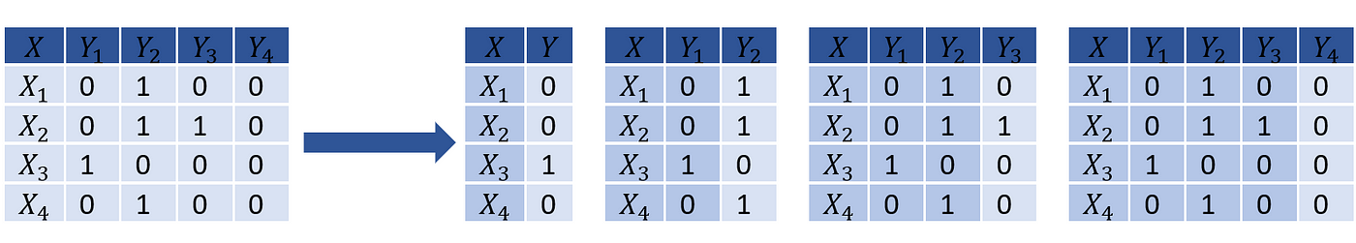

Classifier Chains
Arrange binary classifiers into a chain adding response vector to features.

Slide 12
Multi-Label Classification
0
1
1
0
0
1
1
0
0
0
1
0
1
0
1
0
1
0
1
0
0
1
1
1
0
0
0
Response matrix

Slide 13
Creating a Chain
y
0
1
1
0
0
1
1
0
0
0
1
0
1
0
1
0
1
0
1
0
0
1
1
1
0
0
0
X

Slide 14

Creating a Chain
y
$$y_{1}$$
0
1
1
0
0
1
1
0
0
0
1
0
1
0
1
0
1
0
1
0
0
1
1
1
0
0
0
X

Slide 15
Python
Notes:
Guidelines
Use a title slide at the beginning of your presentation. There are 9 variations of title slides to choose from.
If you will have a series of slideshows, we recommend using the same style of title slide for each presentation.
Keep your title to no more than 2 lines.
Do not change the font style or font size of the title or subtitle.

Slide 16
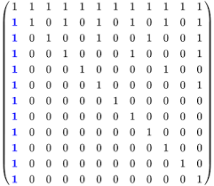

Metrics: Exact Match Ratio
Predictions that are exact matches to the response vectors are considered accurate
Partial matches are considered errors

Slide 17
Python
Notes:
Guidelines
Use a title slide at the beginning of your presentation. There are 9 variations of title slides to choose from.
If you will have a series of slideshows, we recommend using the same style of title slide for each presentation.
Keep your title to no more than 2 lines.
Do not change the font style or font size of the title or subtitle.

Slide 18
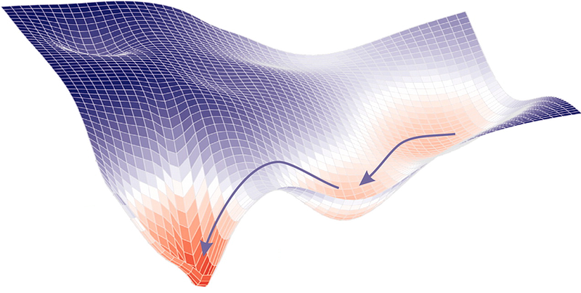
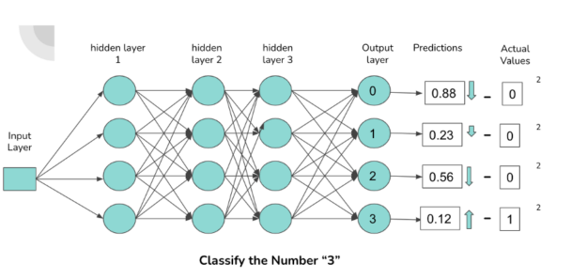

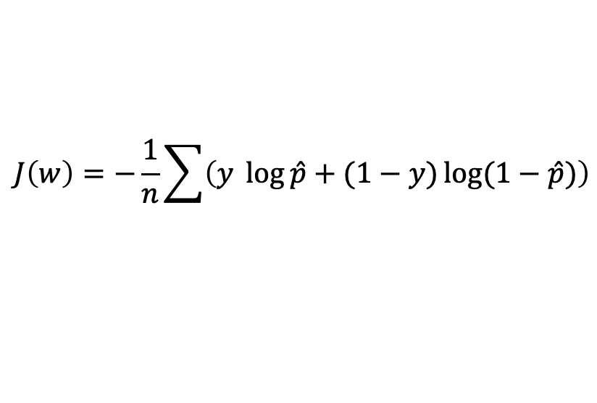


Common Cost Functions Neural Nets
Binary Cross-Entropy
Loss Function
Gradient
$$J\left(w\right)=−\frac{1}{n}\sum{\left(y \log{\hat{p}}+(1−y)\log{(1−\hat{p})}\right)}$$
$∇J\left(w\right)= \hat{p}$ $− y$
$\hat{p}$

Slide 19

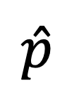
Activation Functions Neural Nets
Common Activations on Layers
ReLu
Tanh
Sigmoid
Output Layer Activation
Sigmoid
$\hat{p}$

Slide 20
Python
Notes:
Guidelines
Use a title slide at the beginning of your presentation. There are 9 variations of title slides to choose from.
If you will have a series of slideshows, we recommend using the same style of title slide for each presentation.
Keep your title to no more than 2 lines.
Do not change the font style or font size of the title or subtitle.

